Slide 1
Trigger -> Service
Pattern so far

Slide 2
High level ‘UML’ diagrams
Following diagrams
Basic class Diagram
Before insert collaboration diagram (assuming service implemented)
After insert collaboration diagram (assuming service implemented)
Red/Orange boxes represent optional classes, although there will be at least one of them per object type (No point in doing this otherwise).

Slide 3
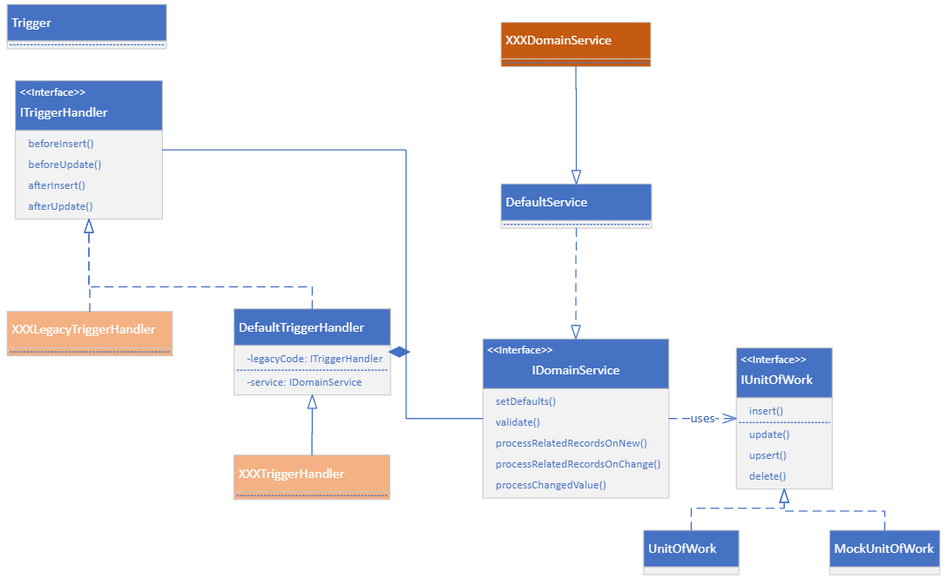

Slide 4
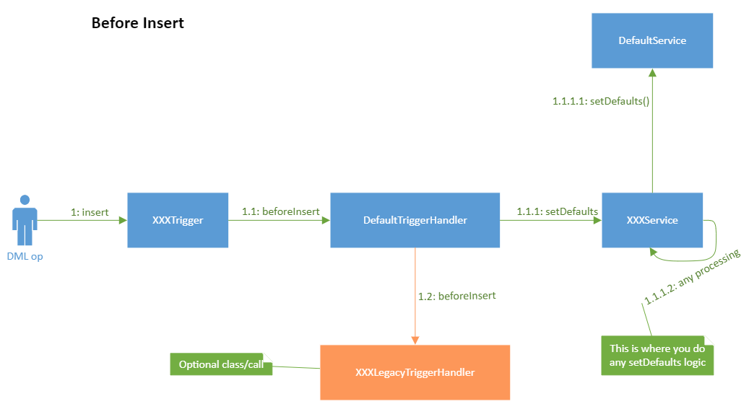

Slide 5
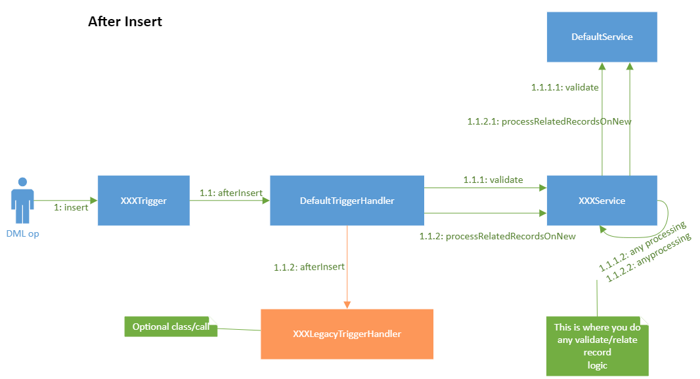

Slide 6
Code Samples
Trigger (with just Legacy conversion)
Trigger (with new Service code)
Trigger (with both Legacy conversion and Service code)
Common Trigger Test

Slide 7
Legacy Code Conversion (1)
trigger Contact on Contact (before insert, before update, before delete, after insert, after update, after delete, after undelete)
{
ITriggerHandler handler = TriggerHandlerFactory.getInstance(Opportunity.SObjectType);
if(handler == null)
{
handler = new DefaultTriggerHandler(new DefaultService(), new LegacyContactTriggerHandler());
}
if (Trigger.isBefore)
{
if(Trigger.isInsert)
{
handler.beforeInsert(Trigger.new);
}
else if(Trigger.isUpdate)
{
handler.beforeUpdate(Trigger.newMap, Trigger.oldMap);
}
else if(Trigger.isDelete)
{
handler.beforeDelete(Trigger.old);
}
}
else if (Trigger.isAfter)
{
if(Trigger.isInsert)
{
handler.afterInsert(Trigger.new);
}
else if(Trigger.isUpdate)
{
handler.afterUpdate(Trigger.newMap, Trigger.oldMap);
}
else if(Trigger.isDelete)
{
handler.afterDelete(Trigger.old);
}
else if(Trigger.isUndelete)
{
handler.afterUndelete(Trigger.new);
}
}
}

Slide 8
Legacy Code Conversion (2)
// bg_Contact_au
// ContactAdviceDetails
public without sharing class LegacyContactTriggerHandler implements ITriggerHandler
{
private boolean isIHasco()
{
return iHASCOUtility.userDivison == 'iHASCO';
}
public void beforeInsert(List<SObject> newRecords)
{
if(isIHasco())
return;
List<Contact> newList = (List<Contact>)newRecords;
new UpdateIndividuals().checktoCallUpdateIndividual(newList, null);
}
public void afterInsert(List<SObject> newRecords)
{
if(isIHasco())
return;
List<Contact> newList = (List<Contact>)newRecords;
TriggerContactHandler.getInstance().onAfterInsert(newList);
}
public void beforeUpdate(Map<Id, SObject> newRecords, Map<ID, SObject> oldRecords)
{
Map<Id, Contact> newMap = (Map<Id, Contact>)newRecords;
Map<Id, Contact> oldMap = (Map<Id, Contact>)oldRecords;
ContactAdviceDetailsHandler.updatePinSetDate(oldMap, newMap);
if(isIHasco())
return;
new UpdateIndividuals().checktoCallUpdateIndividual(newMap.values(), oldMap);
}

Slide 9
New Service Code (1)
trigger Contact on Contact (before insert, before update, before delete, after insert, after update, after delete, after undelete)
{
ITriggerHandler handler = TriggerHandlerFactory.getInstance(Opportunity.SObjectType);
if(handler == null)
{
handler = new DefaultTriggerHandler(new ContactService(), new LegacyContactTriggerHandler());
}
if (Trigger.isBefore)
{
if(Trigger.isInsert)
{
handler.beforeInsert(Trigger.new);
}
else if(Trigger.isUpdate)
{
handler.beforeUpdate(Trigger.newMap, Trigger.oldMap);
}
else if(Trigger.isDelete)
{
handler.beforeDelete(Trigger.old);
}
}
else if (Trigger.isAfter)
{
if(Trigger.isInsert)
{
handler.afterInsert(Trigger.new);
}
else if(Trigger.isUpdate)
{
handler.afterUpdate(Trigger.newMap, Trigger.oldMap);
}
else if(Trigger.isDelete)
{
handler.afterDelete(Trigger.old);
}
else if(Trigger.isUndelete)
{
handler.afterUndelete(Trigger.new);
}
}
}

Slide 10
Legacy Code Conversion (2)
public inherited sharing class ContactService extends DefaultService
{
private ISelector selector;
public ContactService(ISelector selector)
{
this.selector = selector;
}
// see IDomainService
public override void setDefaults(List<SObject> newRecords)
{
List<Contact> newContacts = (List<Contact>)newRecords;
setActive(newContacts);
}
// see IDomainService
public override void processRelatedRecordsOnNew(List<SObject> newRecords)
{
super.processRelatedRecordsOnNew(newRecords);
List<Contact> newContacts = (List<Contact>)newRecords;
optInToMarketing(newContacts, null);
}
// see IDomainService
public override void processRelatedRecordsOnChange(List<SObject> newRecords, Map<Id, SObject> oldRecords)
{
super.processRelatedRecordsOnChange(newRecords, oldRecords);
List<Contact> newContacts = (List<Contact>)newRecords;
Map<Id, Contact> oldContacts = (Map<Id, Contact>)oldRecords;
updateGDPRValuesOnIndividuals(newContacts);
optInToMarketing(newContacts, oldContacts);
}

Slide 11
Trigger Test
@isTest
public class ContactTriggerTest
{
class Factory implements TriggerFrameworkTest.IFactory
{
private Contact record = new Contact(lastName = 'smith');
public ITriggerHandler getTriggerHandler(IDomainService service)
{
return new ContactTriggerHandler(service, null);
}
public SObject getRecordToInsert()
{
return record;
}
public SObject getRecordToUpdate()
{
record.lastName = 'Jones';
return record;
}
public SObject getRecordToDelete()
{
return record;
}
public SObject getRecordToUndelete()
{
return record;
}
}
@isTest
private static void testFramework()
{
TriggerFrameworkTest.testDMLToService(new Factory());
}
}
This code will test the trigger and trigger handler to a high code coverage. The TriggerFrameworkTest class will use the given factory instance to insert, update, delete and undelete a record and test that the trigger ended up calling a service (A mock one). That means that you can then focus on just the service.
This will work well so long as there is not too much other stuff being done outside the trigger (which is why many triggers and flows etc are bad as they make testing hard).
NB the Contact record is fairly simple to test, other record types like opportunities need slightly more setup (as they need an account etc). E.g.
Factory()
{
Account act = new Account(Name = 'Bub');
insert act;
Contact contact = new Contact(lastName = 'Smith');
insert contact;
record = new Opportunity(Name = 'Stuff',
AccountId = act.Id,
ContactId = contact.Id,
StageName = 'Renewal Contact Due',
CloseDate = Date.today()+740);
}

